Slide 1

Identifying and Selecting Projects

Slide 2
Chapter Concepts
How projects are identified and selected
A project charter
Outsourcing projects using a request for proposal
The proposal solicitation process

Slide 3
Learning Outcomes
Discuss how projects are identified and selected
Explain how projects are prioritised and selected
Identify and describe at least eight elements of a project charter
Prepare a project charter
Prepare a request for proposal / understand a tender

Slide 4
Project Integration Management Project Procurement Management
Project Management Knowledge Areas from PMBOK® Guide

Slide 5
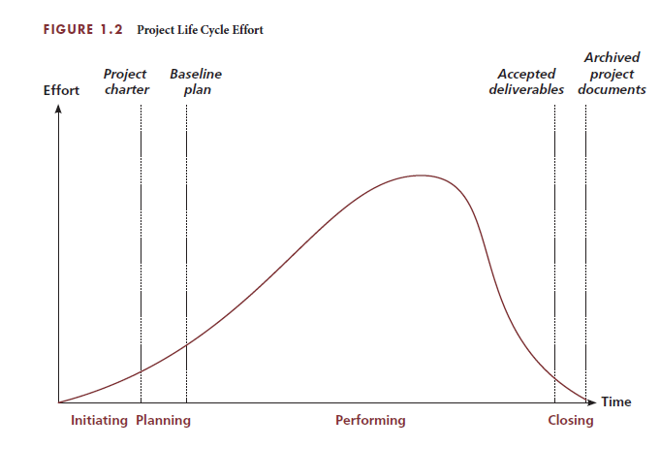
Project Identification
Start of Initiating phase
Recognise need, problem, or opportunity
Various ways for identification
Organisations strategic planning
Response to unexpected events
Group organised to address a need
Important to clearly identify need to determine if worth pursuing
Use decision making process to prioritise and select project with greatest need

Slide 6
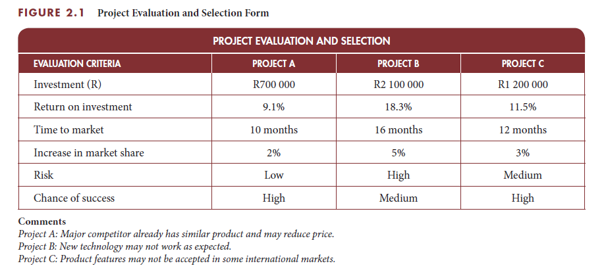
Project Selection
Evaluate needs, costs, benefits
Determine which are projects
Select project
Develop criteria
List assumptions
Gather data
Evaluate each opportunity
Combine ‘gut’ feelings and quantitative information to make decision

Slide 7
Project Charter
Purpose
Possible elements
Provides sponsor approval
Commits funding for the project
Summarises key conditions and parameters
Establishes framework to develop baseline plan
Project title
Purpose
Description
Objective
Success criteria or expected benefits
Funding
Major deliverables
Acceptance criteria
Milestone schedule
Key assumptions
Constraints
Major risks
Approval requirements
Project manager
Reporting requirements
Sponsor designee
Approval signature

Slide 8
Preparing a Request for Proposal
Decision made to outsource to external resource
Comprehensively describe project requirements
Includes need, problem, or opportunity description
Allows contractors to develop a thorough proposal
Facilitates the development of evaluation criteria
May be communicated informally or formally, in writing or verbally

Slide 9
Guidelines for developing an RFP
State project objective or purpose
Provide a statement of work
Include customer requirements
State deliverables the customer expects
State acceptance criteria
List customer supplied items
State approvals required
State type of contract
State payment terms
State schedule and key milestones
List format and content instructions
Indicate due date
Include evaluation criteria
Include level of effort or funds available

Slide 10
Soliciting Proposals
Solicitation
Conditions
Notify potential contractors
Identify selected group in advance to send copy
Advertise in selected journals, newspapers, or websites
Maintain competitive situation
Provide equal information to all bidders
Hold bidders’ meeting to answer questions
Requirements are sometimes communicated verbally instead of via a formal RFP
All RFPs start with identification of a need, problem, or opportunity

Slide 11
Critical Success Factors
The need must be clearly defined before preparing a request for proposal (RFP).
When selecting a project from among several needs or opportunities, the decision should be based on which project will provide the greatest overall benefits compared to its costs and possible consequences.
Having a well-understood evaluation and selection process and a well-rounded committee will increase the chances of making the best project selection decision.
Establish quantitative project success criteria, or expected benefits.
A good RFP allows contractors to understand what the customer expects so that they can prepare a thorough proposal that addresses the customer’s needs and requirements.
A request for proposal should include a statement of work, customer requirements, expected deliverables, and the criteria by which the customer will evaluate proposals.
An RFP should provide instructions for the format and content of contractor proposals so that the customer will be able to make a consistent and fair comparison and evaluation of all the proposals.
Customers must be careful not to provide information to only some of the contractors because it would give these contractors an unfair competitive advantage in preparing their proposals.

Slide 12
Summary
The initiating phase of the project life cycle starts with recognising a need, problem, or opportunity for which a project or projects are identified to address the need.
Sometimes organisations identify several or many needs but have limited funds and people available to pursue potential projects to address all of those needs. In such cases, the company must go through a decision-making process to prioritise and select those projects that will result in the greatest overall benefit.
Project selection involves evaluating potential projects and then deciding which should move forward to be implemented.
Once a project is selected, it is formally authorised using a document referred to as a project charter, sometimes called a project authorisation or project initiation document.
In some cases, an organisation does not have the expertise or staff capacity to plan and perform the project or major portions of the project, and therefore decides to have the project completed by an external resource (contractor) and prepares and RFP.
Once the RFP has been prepared, the customer solicits proposals by notifying potential contractors that the RFP is available.
Not all project life cycles include the preparation of a written request for proposal by a customer and subsequent submittal of proposals from contractors. Some endeavors move from the initiating phase, where a project is identified and selected, into the planning and performing phases of the life cycle.

